Slide 1


Advanced Machine Learning
ITC-6230 Winter 2022
Instructor: Dr. Ioannis Christou
Presented by: Dimitra Kouvara

Slide 2




Table of Contents
Problem Description
Data Pre-processing
Neural Network Model
Evaluation of models
Future Implementation

Slide 3
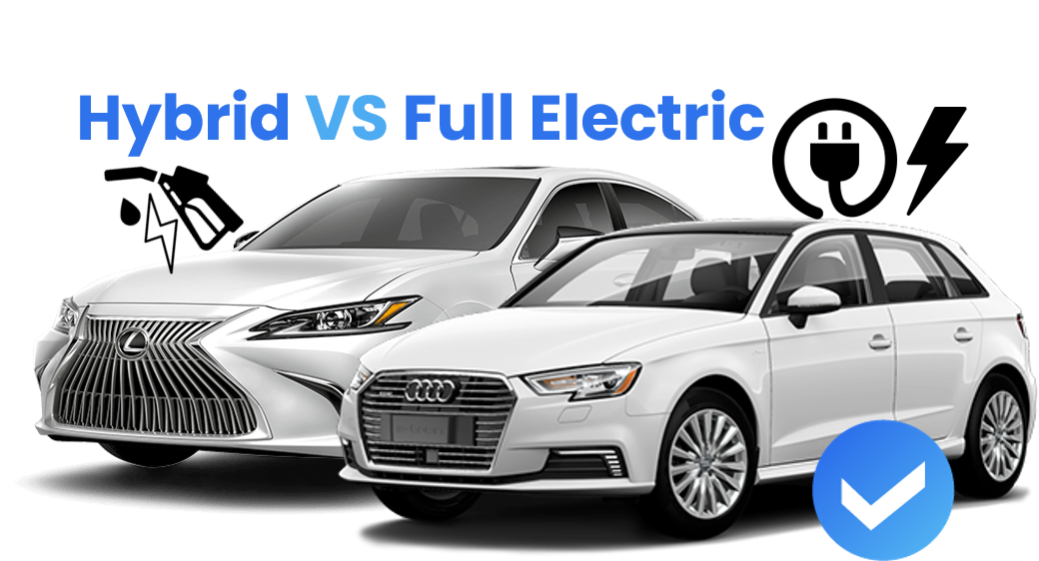
Problem Description
Vehicle selection
Scope
Predicting the selection of the vehicle: electric or hybrid based on user preferences
A binary classification – Regression problem

Slide 4
Data Pre-processing
Treat missing values
Explore correlation
Explore outliers
Under-sampling
Adding Gaussian noise
One hot encoding
Data Normalization
Shuffling & splitting data

Slide 5
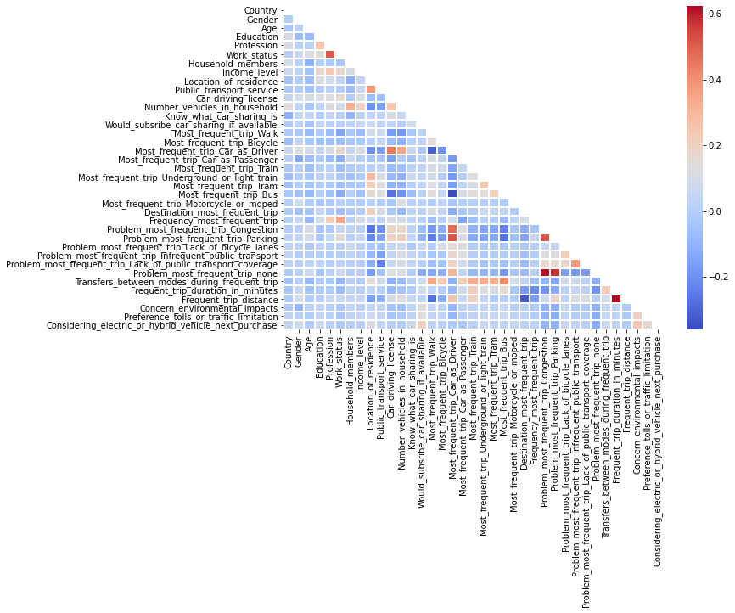
Explore correlation - Outliers

Slide 6
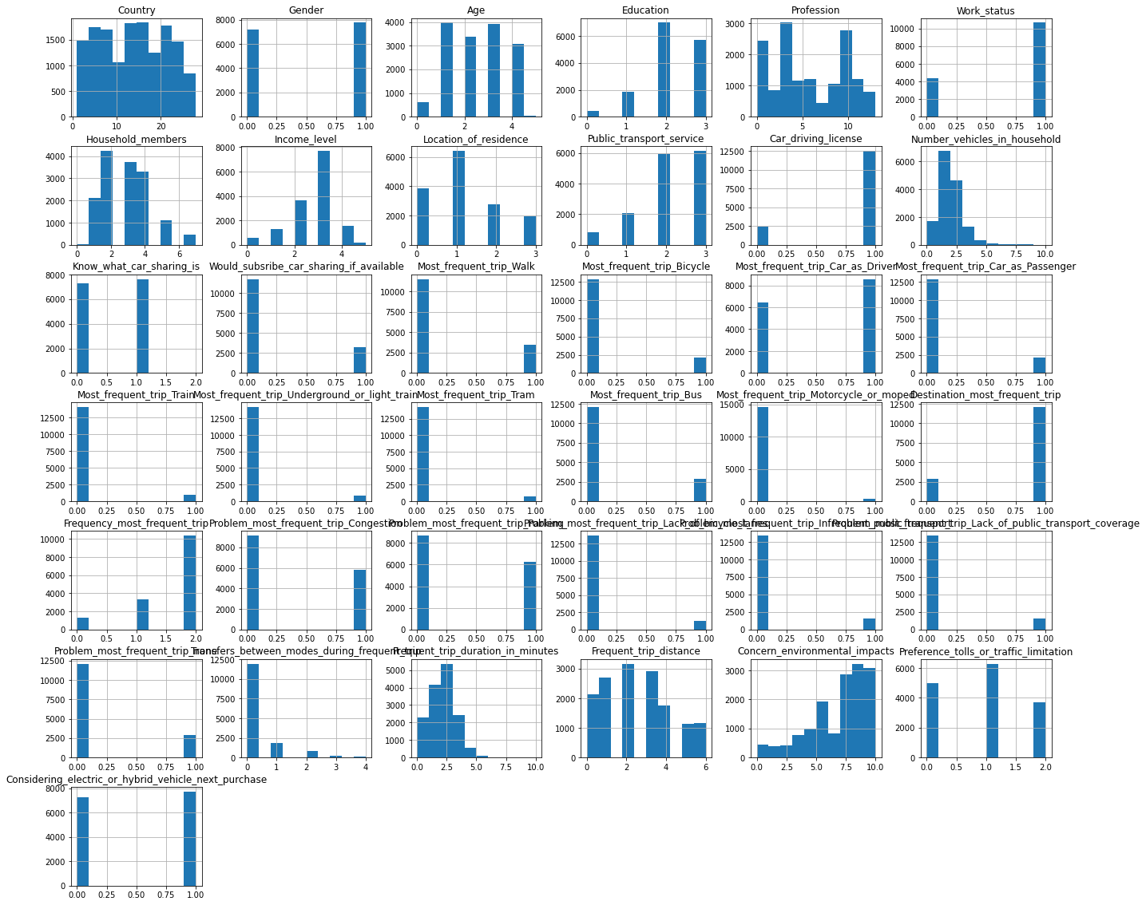
Explore correlation - Outliers

Slide 7
Neural Network Design
Regularization techniques
Updating the weights
Feed forward & backpropagation
Loss functions
Activation functions
Initializing the weights and biases

Slide 8
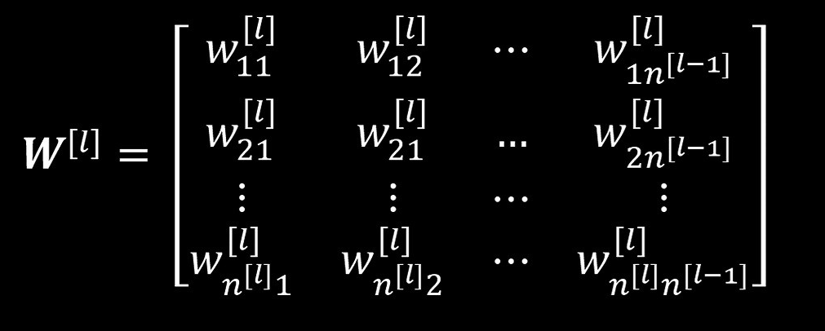
Weights – biases initialization
For the weights
Zeros
Randomly [0,1)
He initialization
Xavier (uniform) initialization
For the biases
Zeros
0.1 when ReLU is applied due to saturation [OPTIONAL]
“We set the biases for each unit to heuristically chosen constants and initialize only the weights randomly.”
Goodfellow, I., Bengio, Y., & Courville, A. (2016). Deep Learning (Adaptive Computation and Machine Learning series) (Illustrated ed.). The MIT Press.

Slide 9
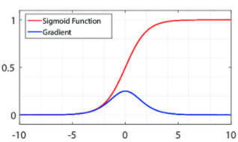
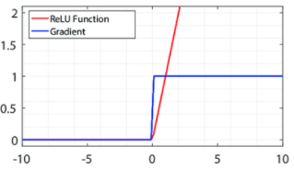
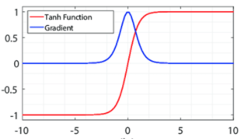
Activation functions
Sigmoid
ReLU
Leaky ReLU
Hyperbolic Tangent
Softmax
Linear
For the output layer
Regression: One node, linear activation
Binary Classification: One node, sigmoid activation
Multiclass Classification: One node per class, softmax activation
Multilabel Classification: One node per class, sigmoid activation

Slide 10
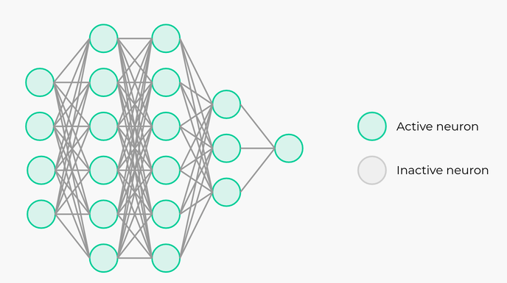
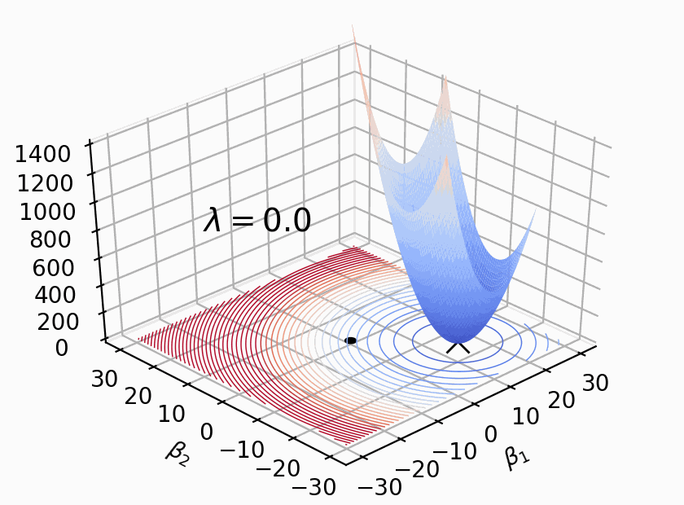
Regularization Techniques
Dropout
L2 regularization

Slide 11
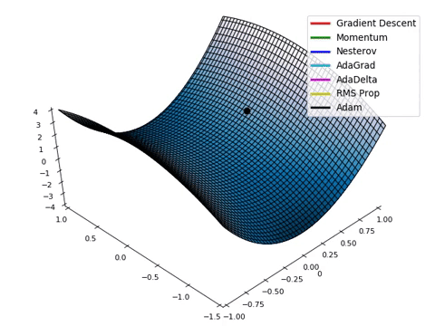
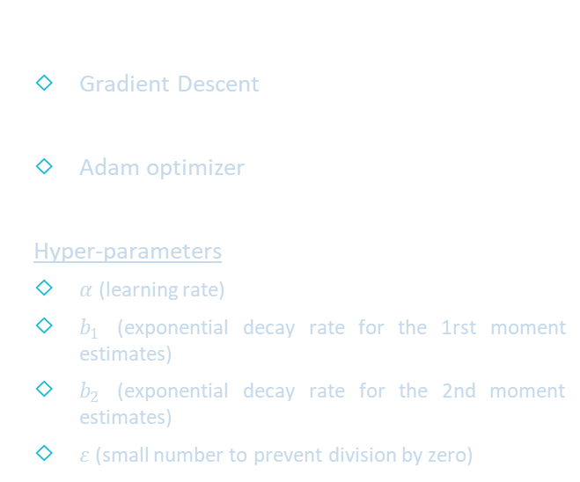
Updating weights
Gradient Descent
Adam optimizer
Hyper-parameters
$α$ (learning rate)
$b_{1}$ (exponential decay rate for the 1rst moment estimates)
$b_{2}$ (exponential decay rate for the 2nd moment estimates)
$ε$ (small number to prevent division by zero)

Slide 12
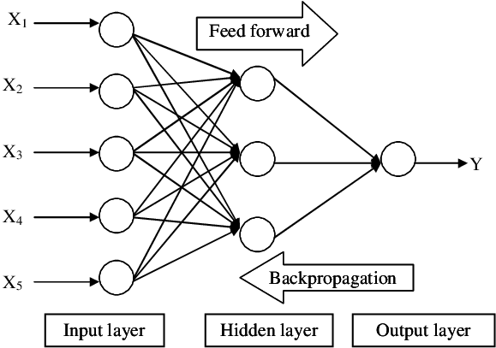
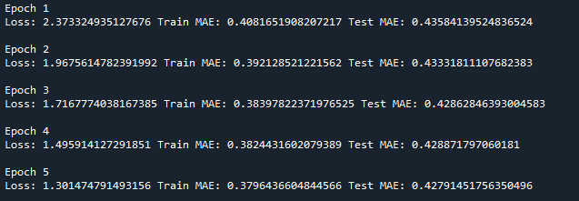
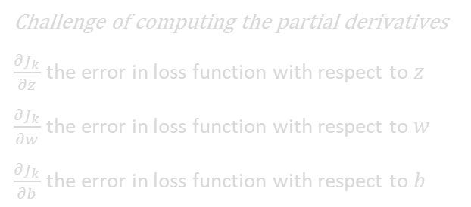
Feed Forward – Backpropagation
Challenge of computing the partial derivatives
$\frac{{∂J}_{k}}{∂z}$ the error in loss function with respect to $z$
$\frac{{∂J}_{k}}{∂w}$ the error in loss function with respect to $w$
$\frac{{∂J}_{k}}{∂b}$ the error in loss function with respect to $b$
The model fitting begins…

Slide 13
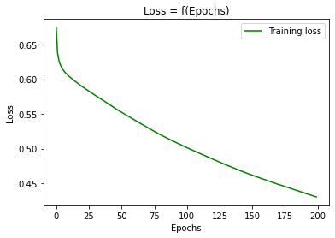
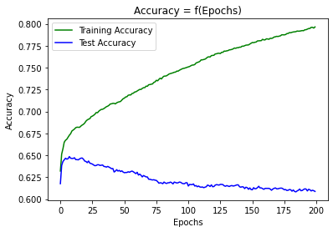
Evaluation – Binary Classification
HIGH VARIANCE OVERFITTING!
Neural Network Architecture
parameters = {'layers': {1: 11, 2: 90, 3: 90, 4: 1}, 'activation': {1: ‘relu', 2: 'relu', 3: 'relu', 4: ‘sigmoid'}}

Slide 14
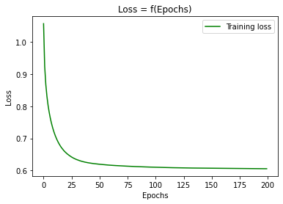
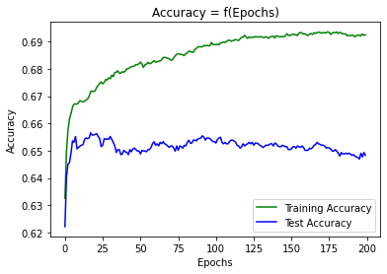

Evaluation – Binary Classification
With L2 Regularization, $λ_{2}=0.1$
Neural Network Architecture
parameters = {'layers': {1: 11, 2: 90, 3: 90, 4: 1}, 'activation': {1: ‘relu', 2: 'relu', 3: 'relu', 4: ‘sigmoid'}}

Slide 15
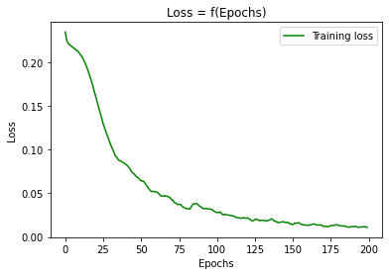
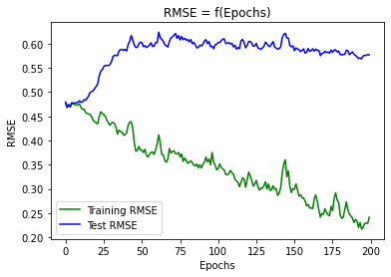
Evaluation - Regression
Without any Regularization
Neural Network Architecture
parameters = {'layers': {1: 425, 2: 268, 3: 100, 4: 58, 5: 1}, 'activation': {1: 'linear', 2: 'relu', 3: 'relu', 4: 'relu', 5: 'linear'}}
Notes:
2350 correct predictions, 1440 = 3790

Slide 16
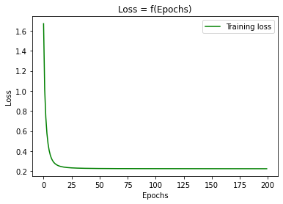
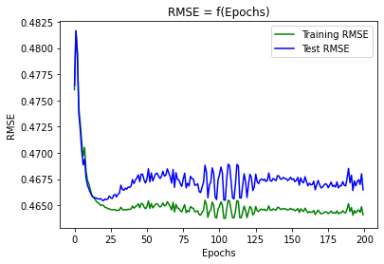

Evaluation - Regression
With L2 Regularization, $λ_{2}=0.1$
Neural Network Architecture
parameters = {'layers': {1: 425, 2: 268, 3: 100, 4: 58, 5: 1}, 'activation': {1: 'linear', 2: 'relu', 3: 'relu', 4: 'relu', 5: 'linear'}}
Notes:
2350 correct predictions, 1440 = 3790

Slide 17
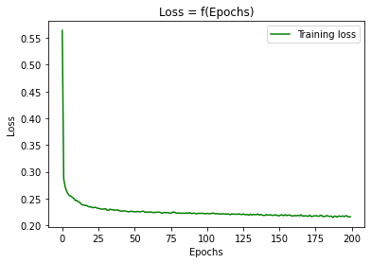
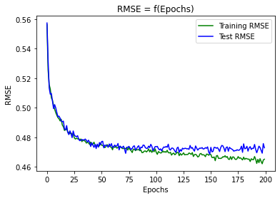
Evaluation - Regression
With Dropout of 0.5
Neural Network Architecture
parameters = {'layers': {1: 425, 2: 268, 3: 100, 4: 58, 5: 1}, 'activation': {1: 'linear', 2: 'relu', 3: 'relu', 4: 'relu', 5: 'linear'}}
Notes:
2350 correct predictions, 1440 = 3790

Slide 18
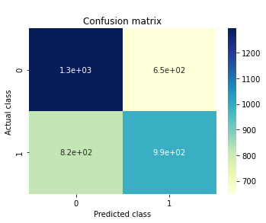
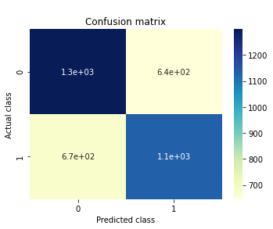
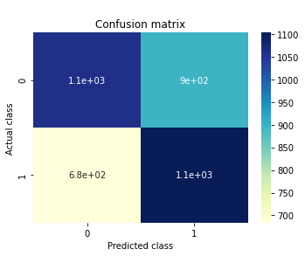
Evaluation – Confusion Matrix for testing data
Binary Classification without any Regularization
Binary Classification with L2 Regularization
Regression without any Regularization

Slide 19
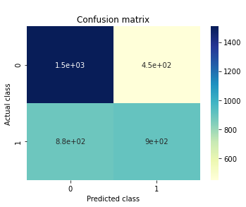
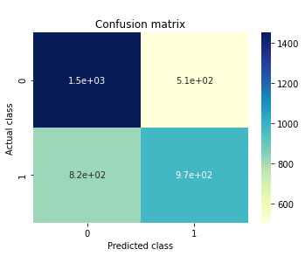
Evaluation – Confusion Matrix for testing data
Regression with L2 Regularization
Regression with Dropout

Slide 20
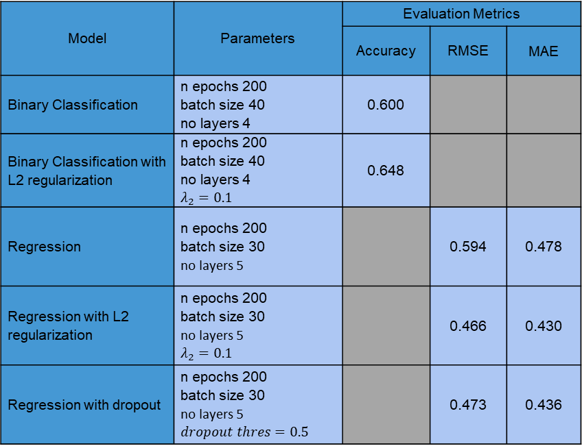
Synopsis Table
Model | Parameters | Evaluation Metrics
 |  | Accuracy | RMSE | MAE
Binary Classification | n epochs 200 batch size 40 no layers 4 | 0.600
Binary Classification with L2 regularization | n epochs 200 batch size 40 no layers 4 $$λ_{2}=0.1$$ | 0.648
Regression | n epochs 200 batch size 30 no layers 5 |  | 0.594 | 0.478
Regression with L2 regularization | n epochs 200 batch size 30 no layers 5 $$λ_{2}=0.1$$ |  | 0.466 | 0.430
Regression with dropout | n epochs 200 batch size 30 no layers 5 $$dropout thres=0.5$$ |  | 0.473 | 0.436

Slide 21
Future Implementation
Support multi-classification problems & regularization techniques for classification problems
Additional pre-processing steps
Optimization for Training Deep Models
Basic Algorithms (Momentum)
Algorithms with Adaptive Learning Rates (AdaGrad, RMSProp)
Regularization Techniques
L1 Regularization
Early Stopping
Grid Search
Learning rate
L2 hyperparameter
Adam hyperparameters

Slide 22
Thank you for your attention

